Slide 1

TIMESHEET VB.NET
Project by: Yashwanth k
Date: 08-08-2019

Slide 2
CONTENTS
Creating FontEnd UI Using Visual Studio
Write Code For UI Functions
Create DataBase Using MYSQL
Write Code For MYSQL Connection
Entering & Retriving Data From MYSQL
Summary & OutLook

Slide 3
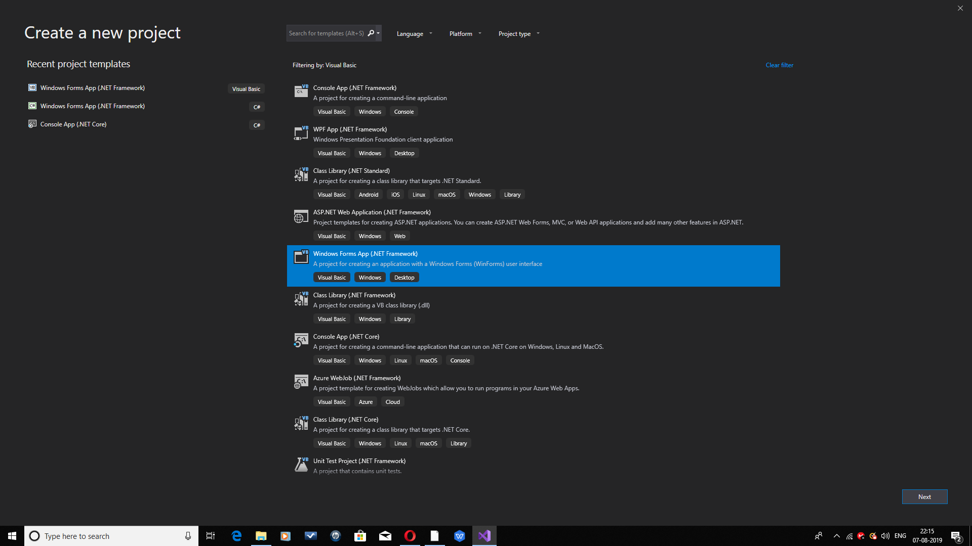
Setting Up With UI Forms
Create
New Project
File ---->NewProject
Opening a New Project with Visual Basic Language.Then Select Windows Form Application to continue with the UI Built.
Using Drag and Drop the Windows Form gets completed.

Slide 4
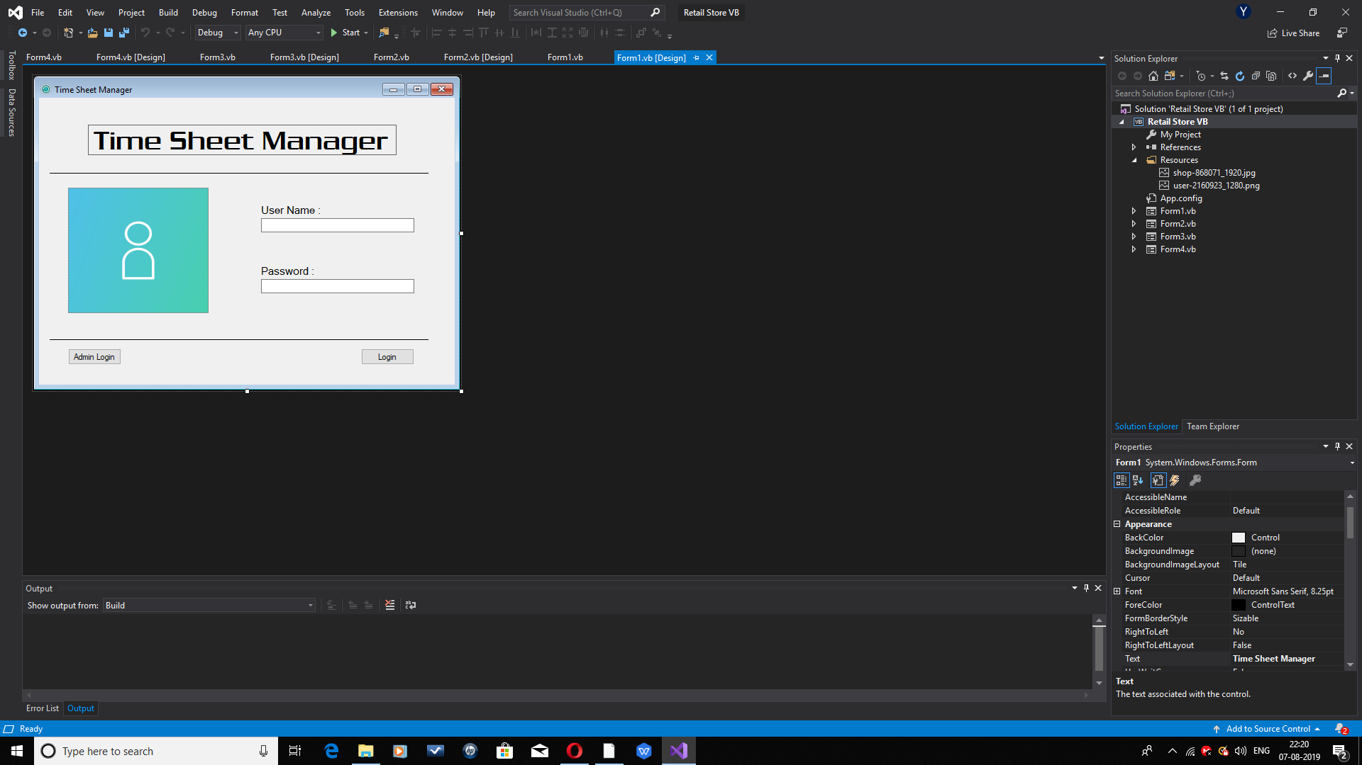
Creating Login Form
Create
Login Form
ADMIN LOGIN ------ USER LOGIN
Using Drag and Drop Functions in Visual Studio Create the Login form for both admin and user.
Both Admin and User Login should have a button functions.

Slide 5
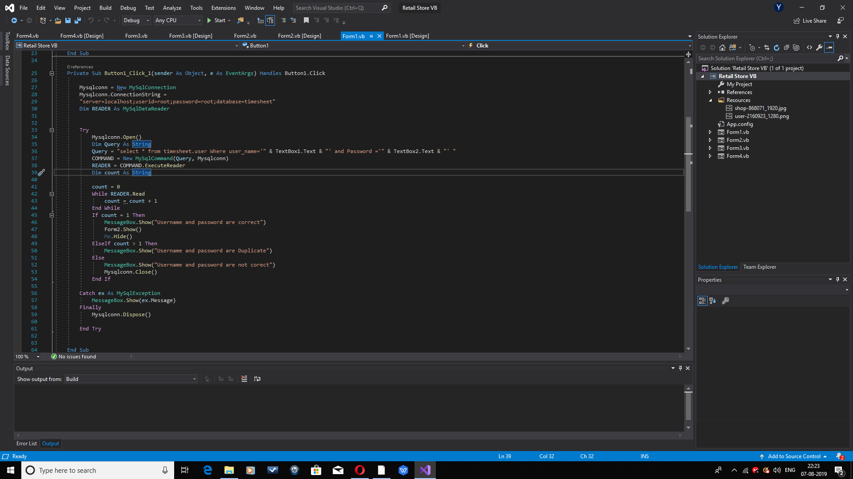
Admin Login & Functions
Admin
Login Functions
ADMIN LOGIN - BUTTON - CODE
Private Sub Button1_Click(sender As Object, e As EventArgs) Handles Button1.Click
Mysqlconn = New MySqlConnection
This Is the Function which is used to connect the Database and retrive data.

Slide 6
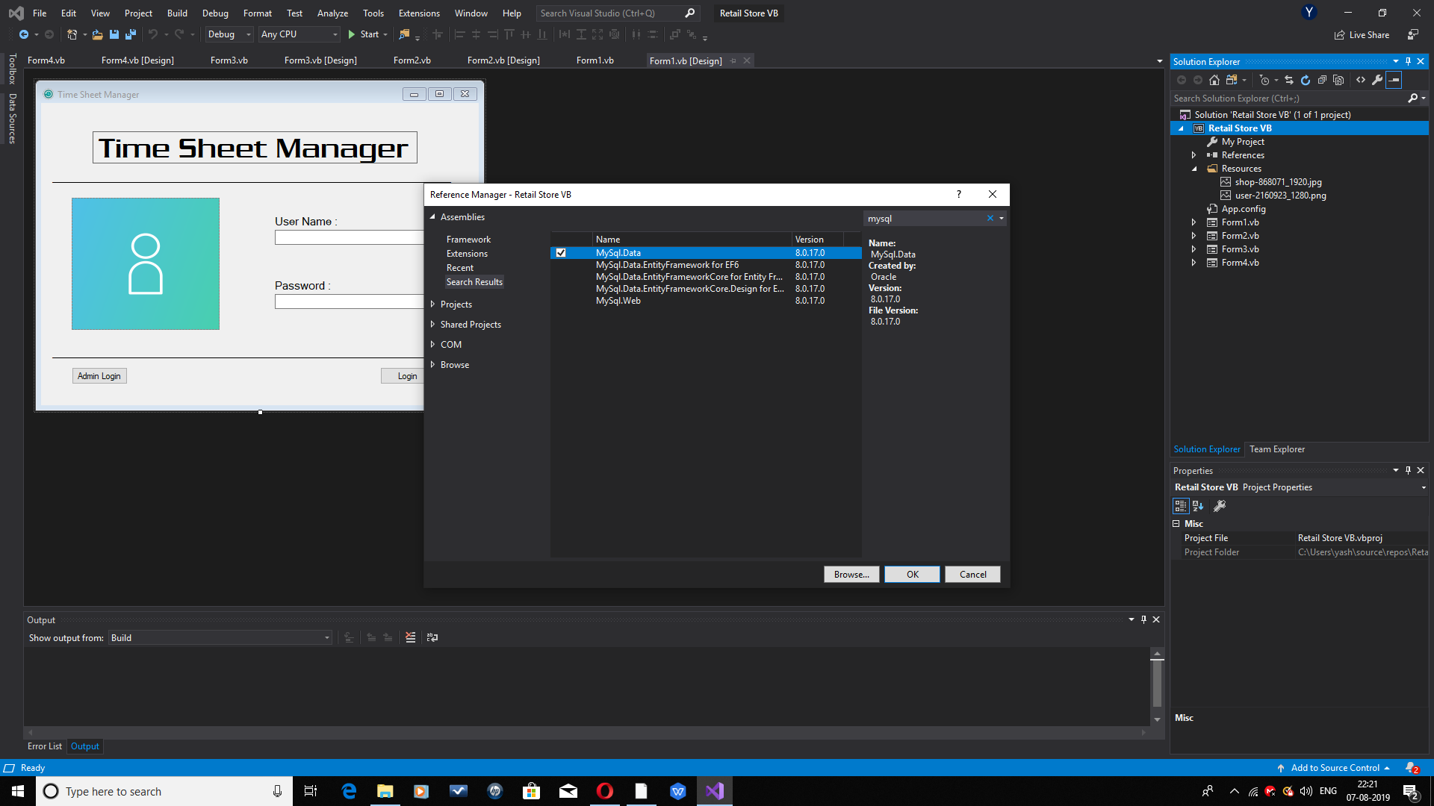
MYSQL Connection Establishment
MYSQL
Connection
ADD REFERENCE ----> MYSQL
Project Name ----> Add -----> Reference---> MySql.Data
This Is the Function which is used to connect the Mysql and Assign to the UI Functions and Create a DataBase.

Slide 7
MYSQL Connection Establishment
MYSQL
Connection
ADD REFERENCE ----> MYSQL
Project Name ----> Add -----> Reference---> MySql.Data
This Is the Function which is used to connect the Mysql and Assign to the UI Functions and Create a DataBase.

Slide 8
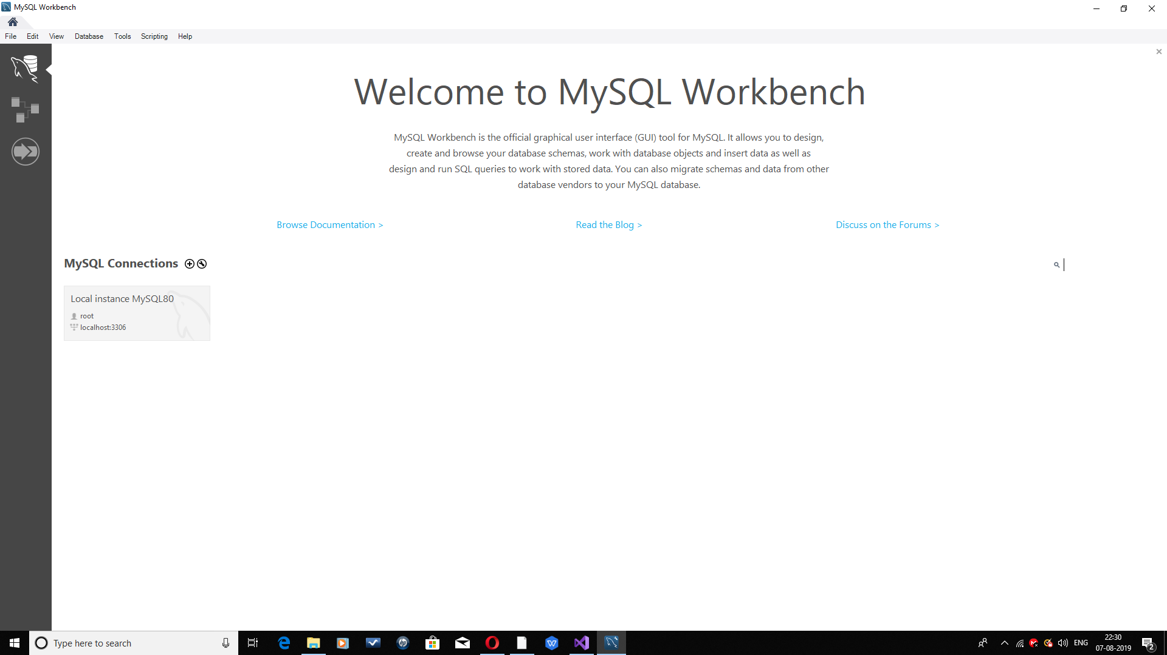
MYSQL SETUP
MYSQL
Setup
MYSQL CONNECTION--->LOCAL HOST
LocalHost MySql.88 is my LocalHost Connection to Visual Studio.
Imports MySql.Data.MySqlClient
Public Class Form1
Dim Mysqlconn As MySqlConnection
Dim COMMAND As MySqlCommand

Slide 9
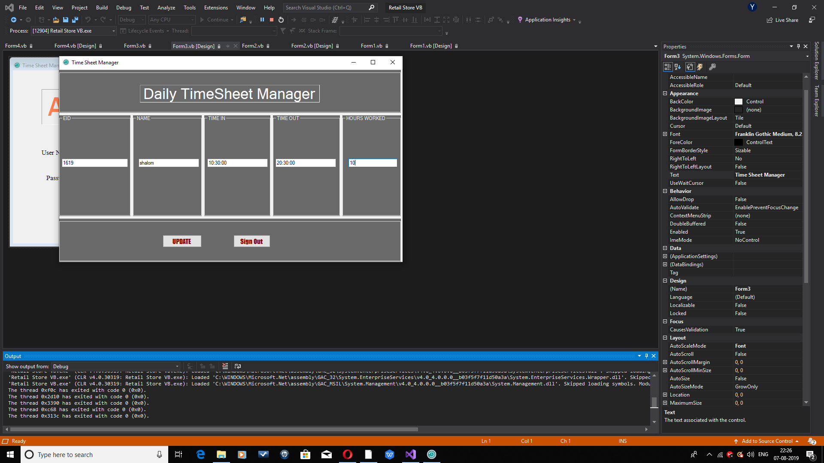
MYSQL DATABASE ENTERY
MYSQL
Data Entery
ADMINFORM--->DATA--->MYSQL
The Data is entered from the Admin login page where there is Textboxes to entry the data and update button to store in DB.
Query = "insert into timesheet.user (EID,NAME,TIMEIN,TIMEOUT,HOURSWORKED) values ('" & TextBox1.Text & "' , '" & TextBox2.Text & "' , '" & TextBox3.Text & "' , '" & TextBox4.Text & "' , '" & TextBox5.Text & "')"

Slide 10
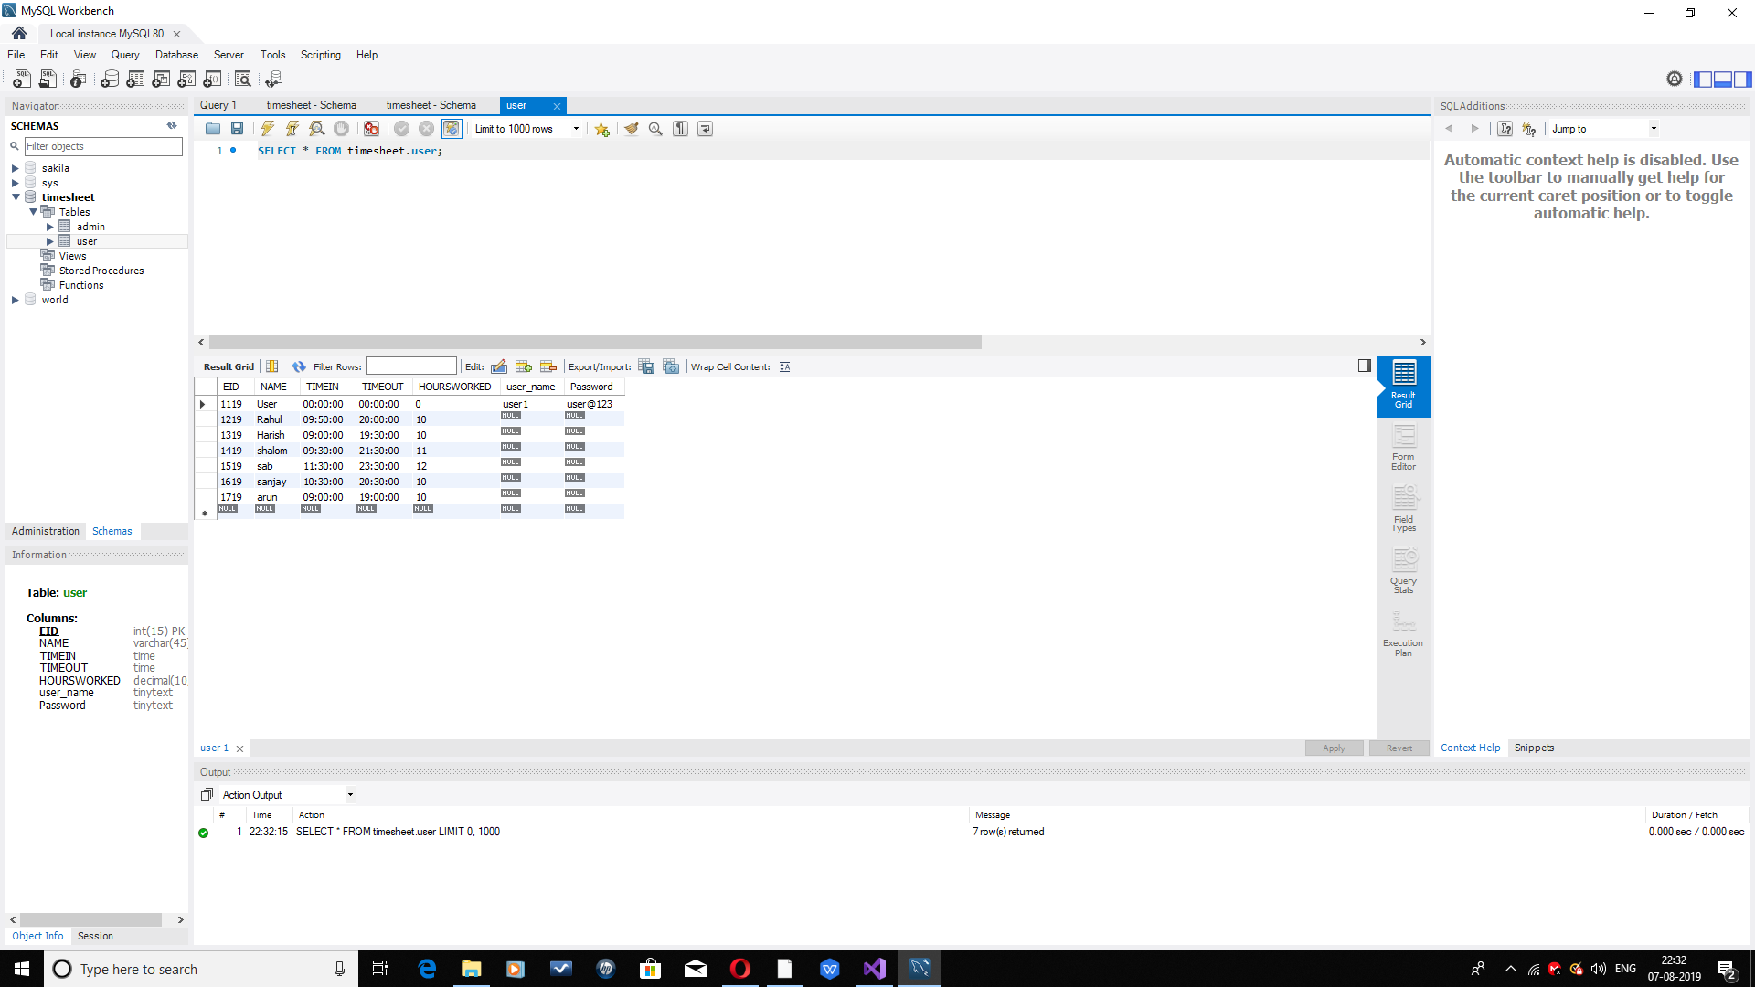
MYSQL TABLE
MYSQL
Data Table
MYSQl---->DATA---->TABLE
The Data is entered from the Admin login page where there is Textboxes to enter the data will be stored in the DB Table.
Query = "insert into timesheet.user
where,
timesheet = database name
user = database table

Slide 11
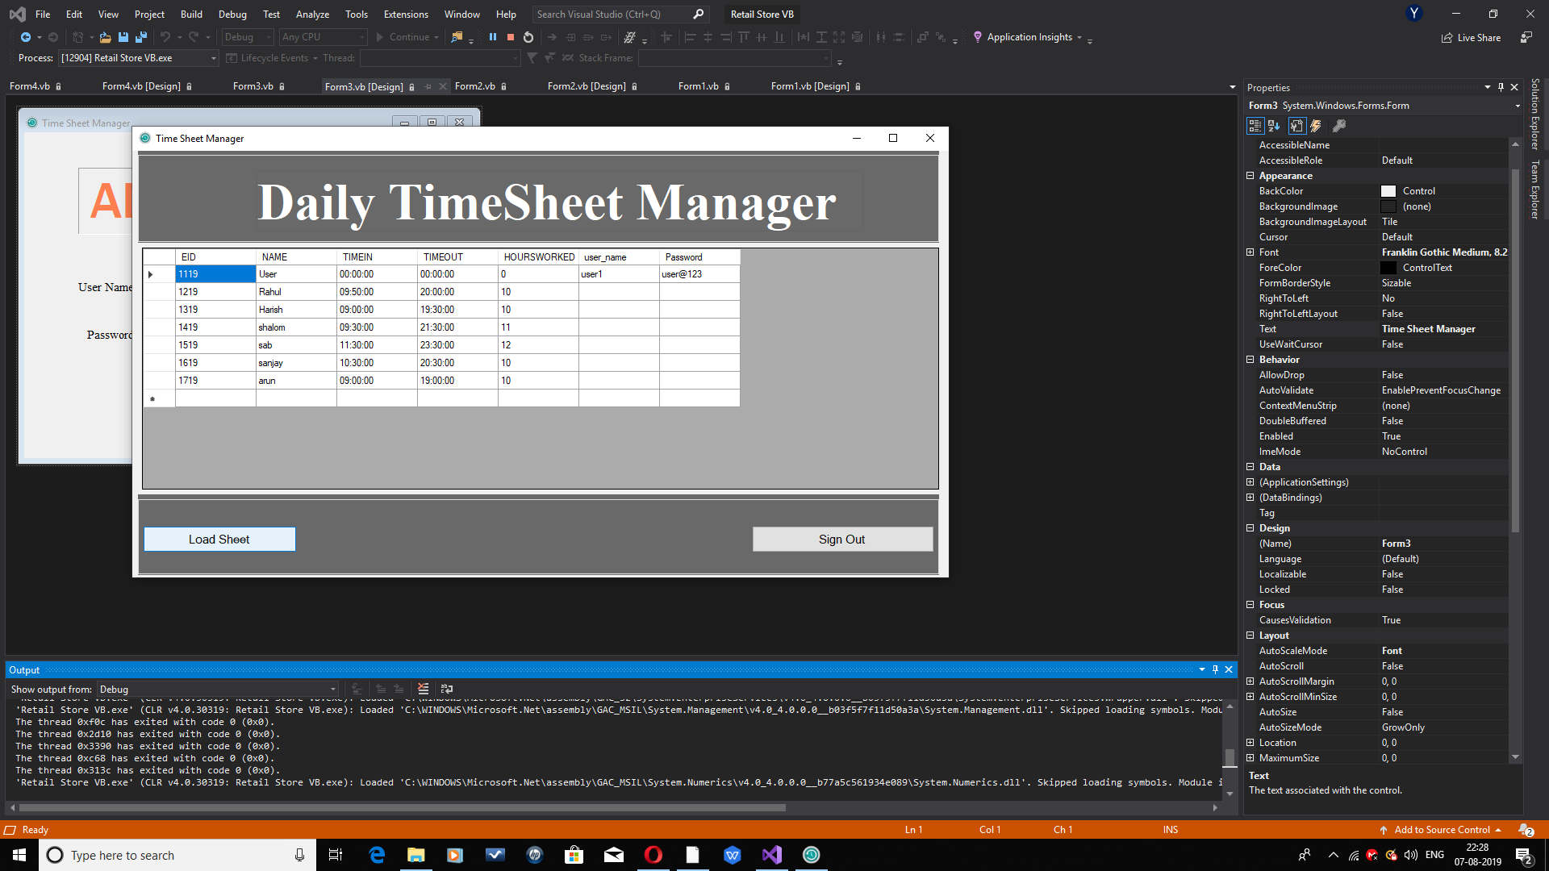
USER LOGIN DATA VIEW
MYSQL
Data Retrieval
MYSQL--->TABLE--->USERFORM
In User Login form the Button = “LOADSHEET”will retrieve the data from MySql DataBase and show it in the user form.
Query = "select * from timesheet.user"
COMMAND = New MySqlCommand(Query, Mysqlconn)
SDA.SelectCommand = COMMAND
Where, [MySqlconn - connection]

Slide 12


PASSWORD AUTHENTICATION
DATABASE VERIFICATION
ADMIN & USER
LOGIN TYPES
TWO DIFFERENT
PACKAGE FORMS

Slide 13
45%
30%
25%
UI
CODING
DATABASE
DRAG AND DROP BUTTONS
LOCATION TRACK
FUNCTIONS FOR UI
WRITE FUNCTION CODING
DATABASE CONNECTION
REQUEST AND RESPOND
MYSQL DATABASE
WRITE QUERIES
TABLES

Slide 14
Thank You
PROJECT BY: YASHWANTH K DATE: 08-08-2019

